Slide 1
Read and translate the words
Electric lamp
Light bulb
Radio
Video recorder
Kinescope
Helicopter
Airplane
Electric arc(электрическая дуга)
High attitude balloon(стратостат)
Steam locomotive
Artificial satellite
Spaceship

Slide 2
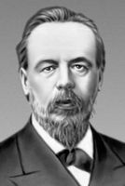
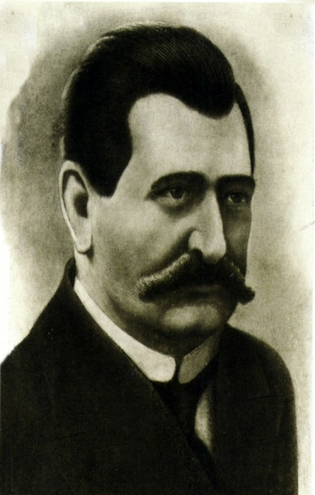
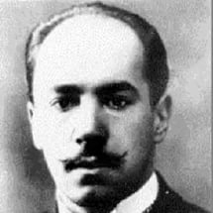
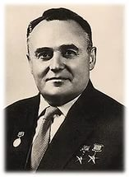
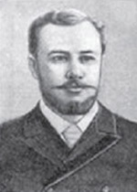
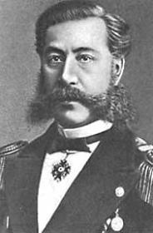
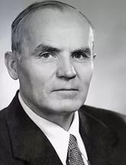
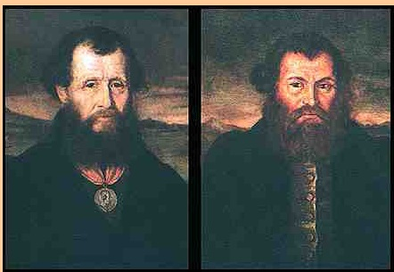
What is the theme of our lesson?

Slide 3
Inventions of Russians sientists
Light bulb – Lodygin A.
Radio – Popov A.
Video recorder – Ponyatov A.
Kinescope – Zworykin V.
Helicopter - Sykorsky I.
Airplane – Mozhaisky A.
Electric arc – Petrov V.
High attitude balloon – Mendeleyev V.
Steam locomotive – Cherepanovs
Artificial satellite – Korolyov S.
Spaceship - Korolyov S.

Slide 4
Make up sentences in Past Simple Passive.
Subject – Verb – Agent
Ex: A portrait was painted by Liz
The Light bulb is was invented by Lodygin A.

Slide 5
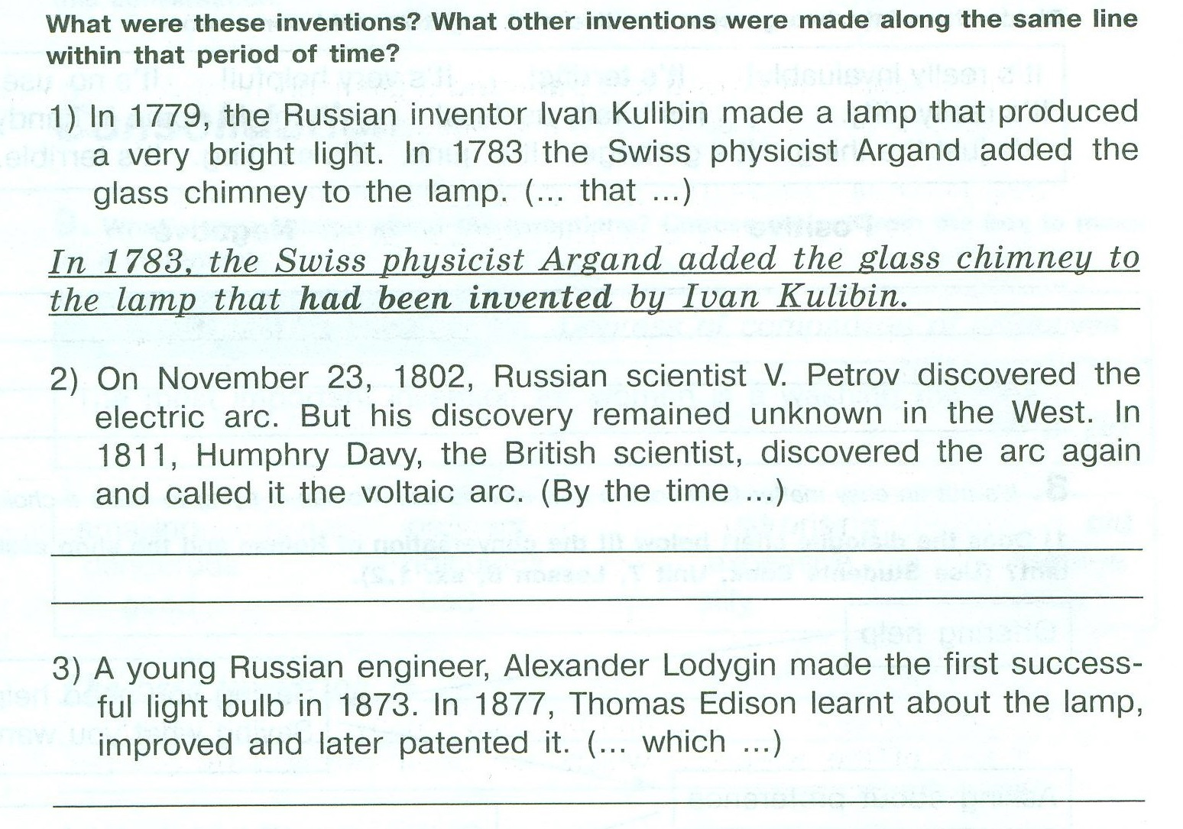
Past Perfect Passive
S - V - A
had been made

Slide 6
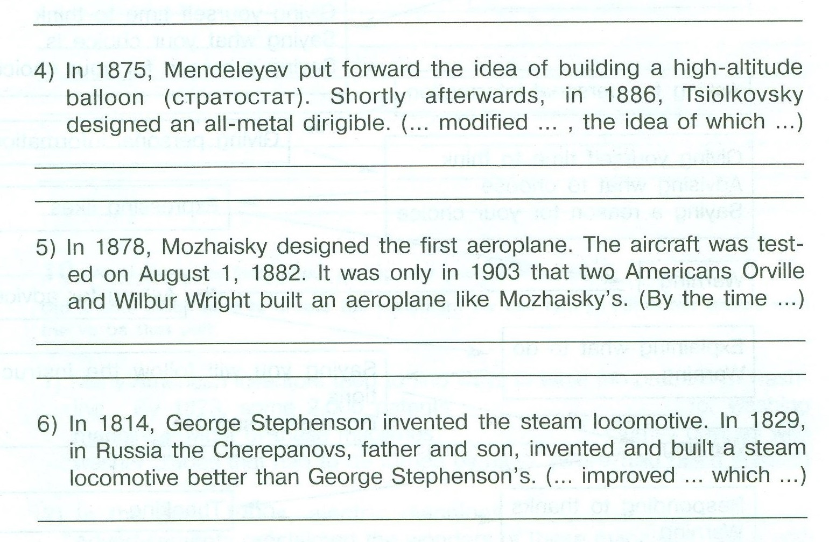

Slide 7
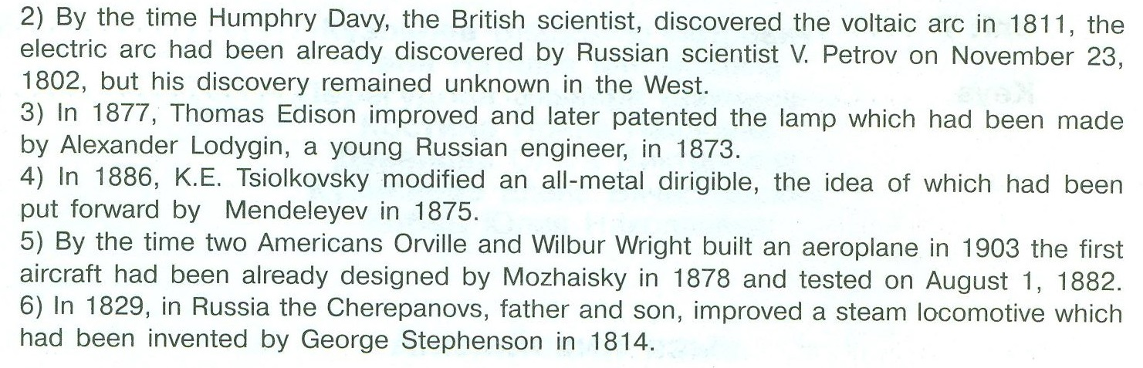
Key

Slide 8

Dynamic pause

Slide 9
Defining – Non – defining clauses
Ex.4b p.145-key
1 Brian, who lives next door, is a graphic designer. ― ND
2 The shop, where I bought my DVD player, sells really up-to-date products. ― ND
3 I’ve just bought a book which is about inventions. ― D
4 Ben, whose father is a software designer, is studying electronics. ― ND
5 Rachel, who originally trained as a teacher, won the Businesswoman of the Year Award. ― ND
6 I live in the centre of the city which is very noisy. ― D

Slide 10
Relative clauses
We use:
who(m)/that to refer to people
which/that to refer to things
whose with people, animals and objects to show possession
when/that to refer to a time
where to refer to a place
why to give a reason

Slide 11
Work yourself
Grammar Check module 8
1 variant 2 variant
ex.5, 7. p. 180-181 ex6, 8 p.180-181

Slide 12
Keys
1 variant
Ex 5
1 who 4 which/that 6 where 2 which 5 who/that 7 when 3 that/which
Ex7
1 which (YES) 2 whose (NO) 3 where (NO) 4 when (NO) 5 why (NO) 6 who/that, whose (YES) (NO) 7 who, who (NO) (NO)

Slide 13
Keys
2 variant
Ex6
2 whose ND YES 3 which/that D NO 4 who D NO 5 where D NO 6 who ND YES 7 which D NO 8 who ND YES 9 where D NO 10 which/that D NO.
Ex8
2 Greg’s new digital camera, which/that cost him a fortune, doesn’t work. 3 Here’s an ad for the laptop which/that I think I’ll buy. 4 This is the laptop which/that I bought from a friend. 5 I’m reading The Time Machine which/that was written by H. G. Wells. 6 My friend bought a new MP3 player which/that stores up to 5GB of music. 7 This is Mr Key, who is my Physics teacher. 8 The CD-ROM, which/that I ordered weeks ago, was delivered today.

Slide 14
Home task
W.B. ex5, 6 p.62-63
G.R. p.18-19(student book)

Slide 15
Источники:
https://yandex.ru/images/search?text=русские%20изобретатели&parent-reqid=1485848601885382-986500187276853849391355-sas1-5663
http://pptcloud.ru/fizkultura/zaryadka-dlya-glaz

